Slide 1
Lead Scoring Case Study
Edu Jockers, Ironhack Data Analytics Bootcamp, Final Project, Berlin 2021

Slide 2
Agenda
Introduction
Problem Statement
Business Objective
Data Set Overview
Data Preparation
Important Variables
ROC AUC
Lead Score Calculation
Recommendations

Slide 3
Problem Statement
Build a Logistic Regression Model to predict whether a lead for online courses for an education company would be successfully converted or not.

Slide 4
Business Objective
Help the company to select the most promising leads (Hot Leads), i.e. the leads that are most likely to convert into paying customers.
Build a logistic regression model to assign a lead score value between 0 and 100 to each of the leads which can be used by the company to target potential leads.

Slide 5
Introduction
The company “X Education” sells online courses to industry professionals
The company gets its leads through past referrals or websites and search engines
Once these leads are acquired, employees from the sales team start making calls, writing emails, etc. Through this process, some of the leads get converted while most do not. The typical lead conversion rate at X education is around 30%.
The CEO, in particular, has stated that the objective lead conversion rate should be about 80%.
I have used WOE approach to encode categorical variables
The model performance will be judged using metrics such as sensitivity, recall, precision

Slide 6
Data Set overview
The data provided contains demographic and website activity information for each potential lead collected by an online education company
The data set contains 9240 rows, 37 columns, .csv file
There are 17 columns with no data.
Seven columns contain more than 45% unknowns
There are no rows with more than 50 % null values.
No Duplicates in the Data Set

Slide 7
Data Preparation
Remove columns which has only one unique value.
Removing rows where a particular column has low missing values
Handling “Select” values in some columns
Outlier Treatment
Dummy variables were created
Splitting of Data into Train - Test data sets

Slide 8
Important Variables
Following variables contribute the most towards the probability of a lead getting converted:
Total Time Spent on Website
Current occupation
Do Not Email
Last Activity
Lead Source
Page Views Per Visit
Last Notable Activity
Total Visits
Specialization

Slide 9
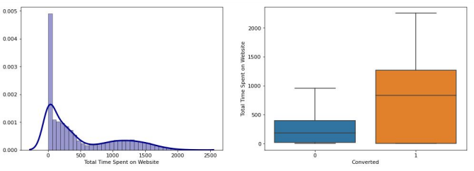
Total Time Spent on Website
The candidates who spend more time on the website show higher rate of conversion

Slide 10
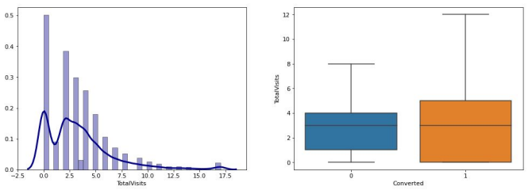
Total Visits
The candidates who visit the website more often show slightly higher rate of conversion.

Slide 11
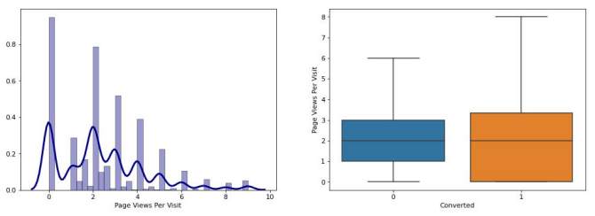
Page Views Per Visit
The candidates who view more website pages per visit show slightly higher rate of conversion

Slide 12
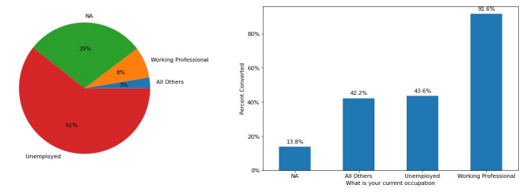
Current Occupation
The candidates who are working professionals have the highest rate of conversion whereas those whose occupation is NA (Not Available) have the lowest rate of conversion

Slide 13
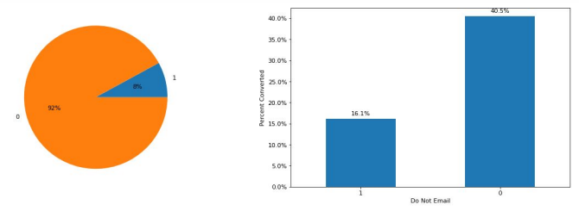
Do Not Email
The candidates who opt to receive emails about the course have the highest rate of conversion whereas those who opt not to receive emails have the lowest rate of conversion

Slide 14
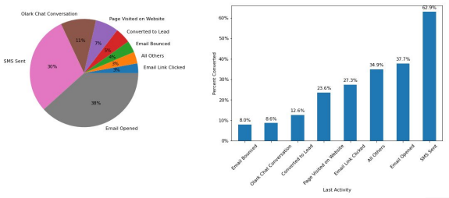
Last Activity
The candidates whose last activity is “SMS Sent” have the highest rate of conversion whereas those whose last activity is “Email Bounced” have the lowest rate of conversion

Slide 15
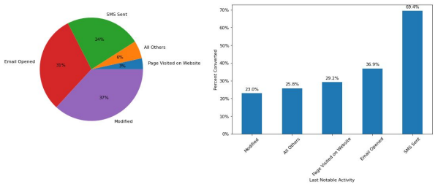
Last Notable Activity
The candidates whose Last Notable Activity is “SMS Sent” have the highest rate of conversion whereas those whose Last Notable Activity is “Modified” have the lowest rate of conversion

Slide 16
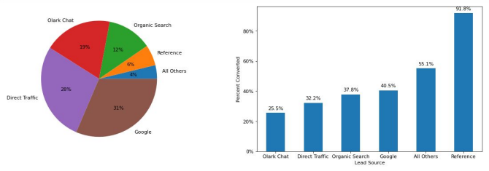
Lead Source
The candidates whose lead source is “Reference” have the highest rate of conversion whereas those whose lead source is “Olark Chat” have the lowest rate of conversion

Slide 17
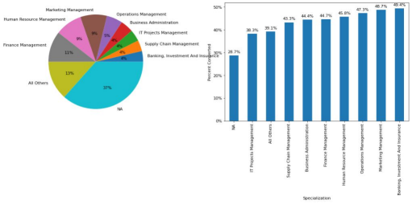
Specialization
The candidates whose Specialization is “Banking,Investment and Insurance” have the highest rate of conversion whereas those whose Specialization is “NA” have the lowest rate of conversion

Slide 18
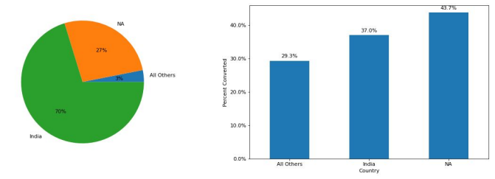
Country
The candidates from countries other than India have the lowest rate of conversion

Slide 19
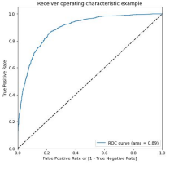
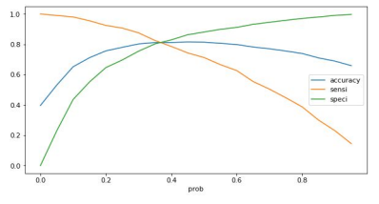
ROC AUC
The ROC AUC of the model is 0.89
The optimal cut-off is at 0.35. The accuracy, sensitivity and specificity at this cut-off are approximately 0.8.

Slide 20
Accuracy, Sensitivity and Specificity
Train Data:
Accuracy: 90.81 %
Sensitivity: 87.53%
Specificity: 92.83%
Test Data:
Accuracy: 91.53%
Sensitivity: 89.89%
Specificity: 92.57

Slide 21
Lead Score Calculation
Formula for Lead Score calculation is:
Lead Score = 100 * Conversion Probability
The Conversion Probability is multiplied by 100 to obtain the Lead Score for each Lead.
Higher the Lead Score, higher is probability of a lead getting converted and vice versa.

Slide 22
Recommendations
I recommend the sales team to focus on candidates who:
Are more engaged on the website (spend more time, visit more often, visit more pages per visit)
Are working professionals
Opt to receive emails about the course
Have their last activity as “SMS Sent”
Came through a reference
The ideal approach would be to start calling prospects with the highest predicted conversion probability first and go down that list as far as required.

